Slide 1
Approval Prediction to get a Loan
Mark Christian Albinto
Video Link: https://www.youtube.com/watch?v=EgN11J8qGYM

Slide 2
Phase 3 Data Preparation
Filling in missing values
Using the isnull().sum() method, count the number of missing values in each column as the first step. This will provide us with a total of the columns' missing values.
Checking Outliers
Data points known as outliers differ greatly from the rest of the data in a dataset. Measurement problems, data input errors, or other unusual occurrences can all lead to outliers. They can have a significant impact on statistical analysis and machine learning algorithms, leading to inaccurate results.
Encoding Categorical Variables
The scikit-learn library's LabelEncoder is used to transform categorical data into numerical values. Each category in the variable is given a distinct integer value by the LabelEncoder.

Slide 3
Phase 4 Modelling
Model Selection
Using StratifiedKFold to determine which machine learning classifier is suitable for the problem
Input Feature Selection
There are a number of variables in our dataset, including Loan_Status, Dependents, Gender, Married, Education, Self-Employed, ApplicantIncome, CoapplicantIncome, LoanAmount, Loan_Amount_Term, and Property_Area. To investigate the connections between these variables, we can construct a correlation matrix.
Modelling
Logistic regression is a supervised machine learning algorithm that is used for binary classification problems. It is a sort of regression analysis where the outcome (or dependent variable) is categorical in nature and is used to forecast the likelihood that an event will occur.

Slide 4
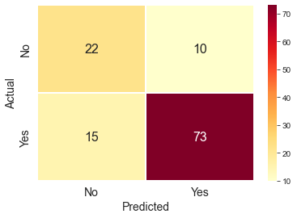
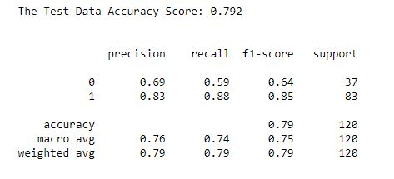
Phase 5 Evaluation
Confusion Matrix
Accuracy Score

